Slide 1
Topic: Structure
IPRO 497-221
Hong Zhang

Slide 2
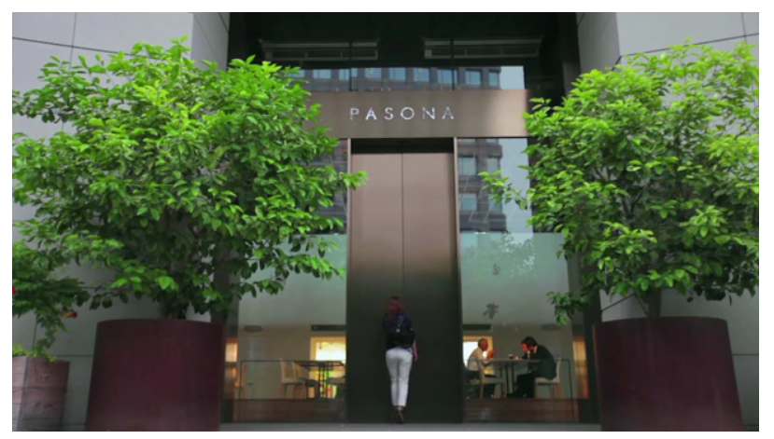
Types
Notes:
http://www.archdaily.com/428868/in-tokyo-a-vertical-farm-inside-and-out

Slide 3
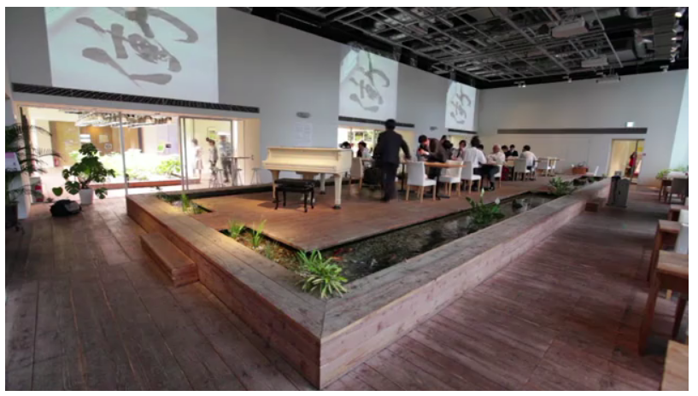
Types
Notes:
http://www.archdaily.com/428868/in-tokyo-a-vertical-farm-inside-and-out

Slide 4
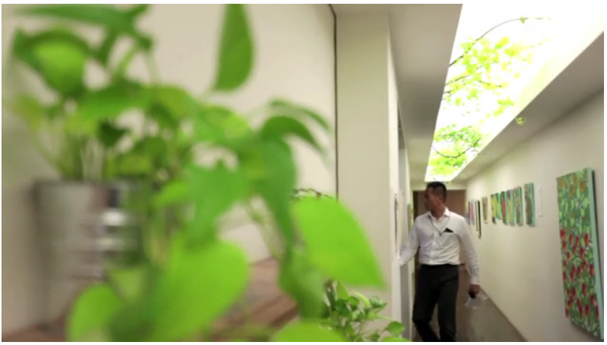
Types
Notes:
http://www.archdaily.com/428868/in-tokyo-a-vertical-farm-inside-and-out

Slide 5
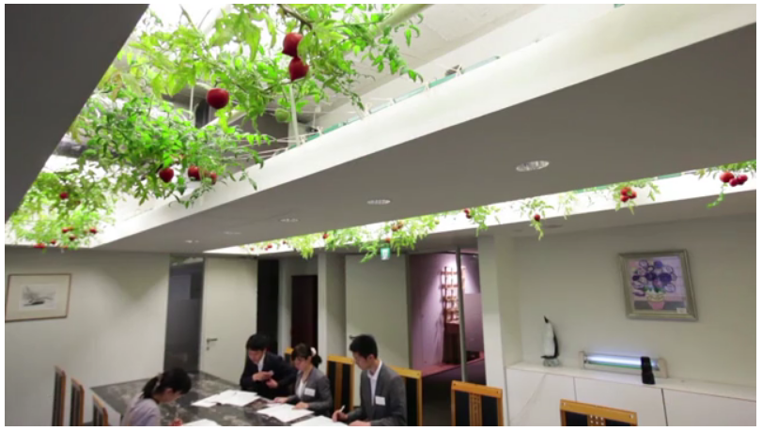
Types
Notes:
http://www.archdaily.com/428868/in-tokyo-a-vertical-farm-inside-and-out

Slide 6
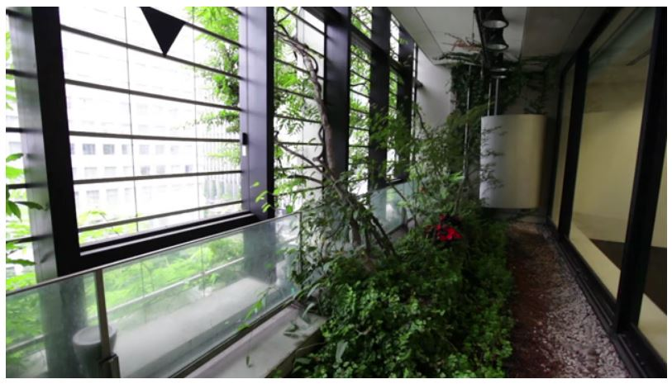
Types

Slide 7
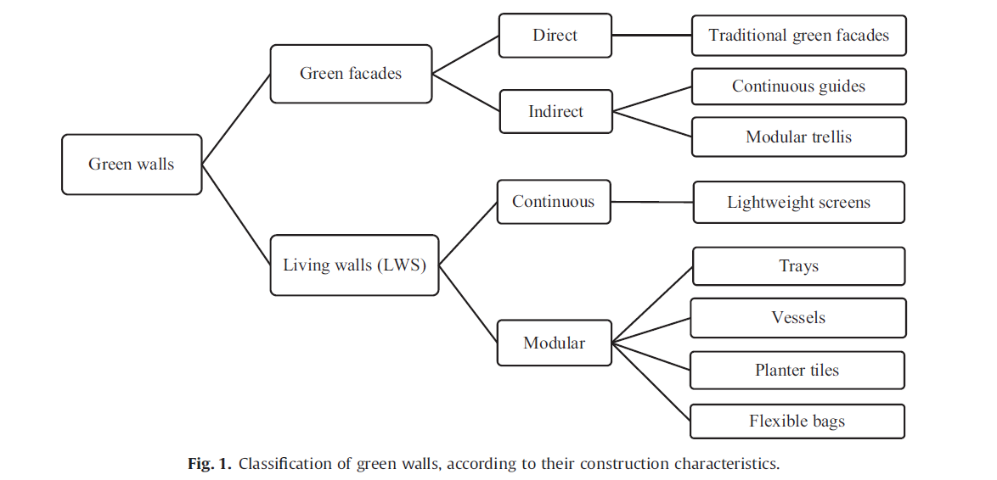
Types

Slide 8
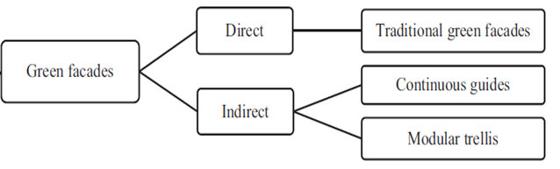
Green Facade
‘Green Facade’ or facade greening, features a training structure that supports vines or climbing plants growing upward from the ground away from the building (GW101, 2008).
Indirect systems need a variety of climbing plant material, can be customized and some are available in a variety of colors.
Notes:
http://www.greenroofs.com/archives/green_walls.htm

Slide 9
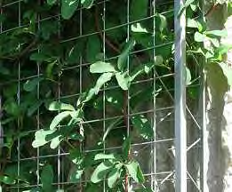
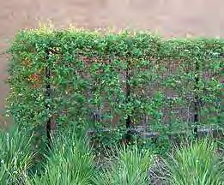
Green Facade
Continuous Guides Panel System: use either cables and/or a wire-net attach to the building wall.
Notes:
http://www.greenroofs.com/archives/green_walls.htm

Slide 10
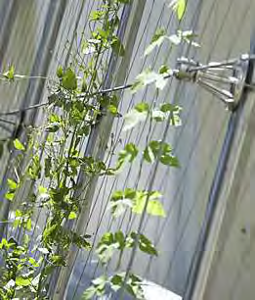
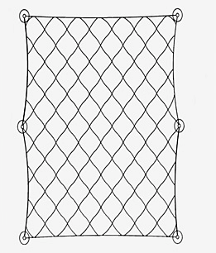
Green Facade
Modular Trellis Panel System: a rigid, light weight, three-dimensional panel
made from a powder coated galvanized and welded steel wire that supports plants with both a face grid and a panel depth. This system is designed to hold a green facade off the wall surface so that plant materials do not attach to the building.
Notes:
http://www.greenroofs.com/archives/green_walls.htm

Slide 11
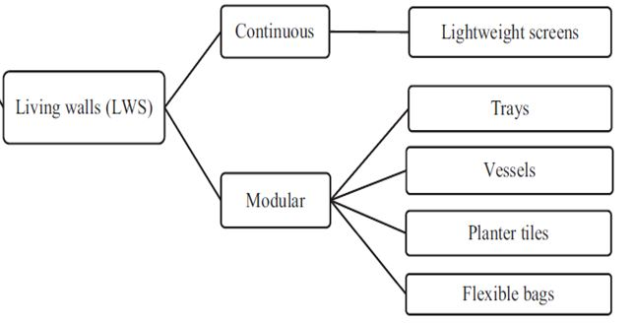
Living Wall
• ‘Living Wall’ is part of a building envelope system, comprising pre-vegetated or planted on-site panels containing plants, growing medium or liquid nutrient installed in or on a frame, secured to a structural wall or it can be free standing (GW101, 2008).
Modular systems consist of square or rectangular panels that hold growing media to support plant material. The composition of the growing medium may be tailored to the unique combination of plants selected, and to other design objectives. Most of the nutrient requirements for the plants can be found in the growing media within the modules.

Slide 12
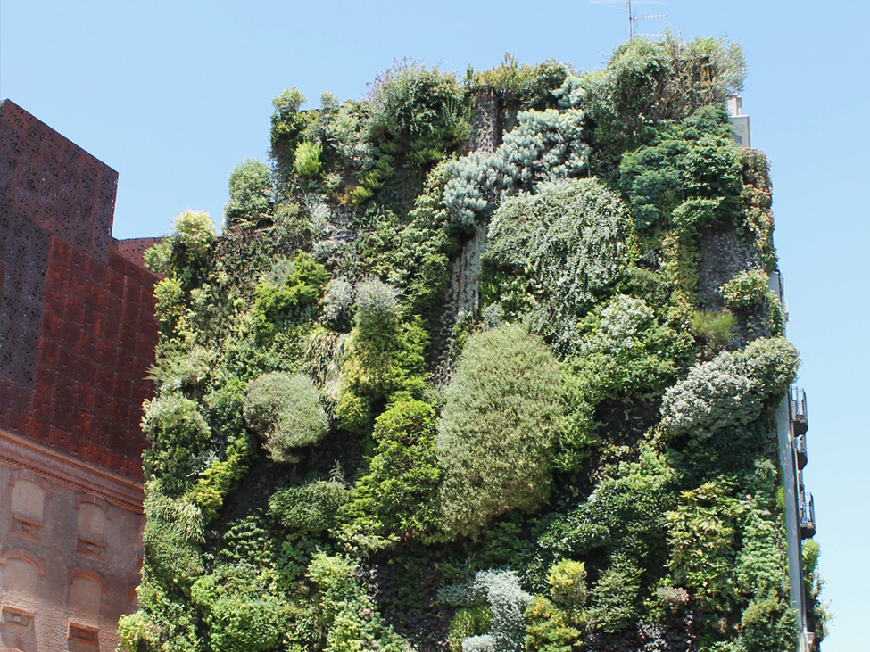
Living Wall
Continuous living walls are based on the application of lightweight and permeable screens in which plants are inserted individually
Continuous living wall system, Caixa Forum, Madrid, June 2013

Slide 13
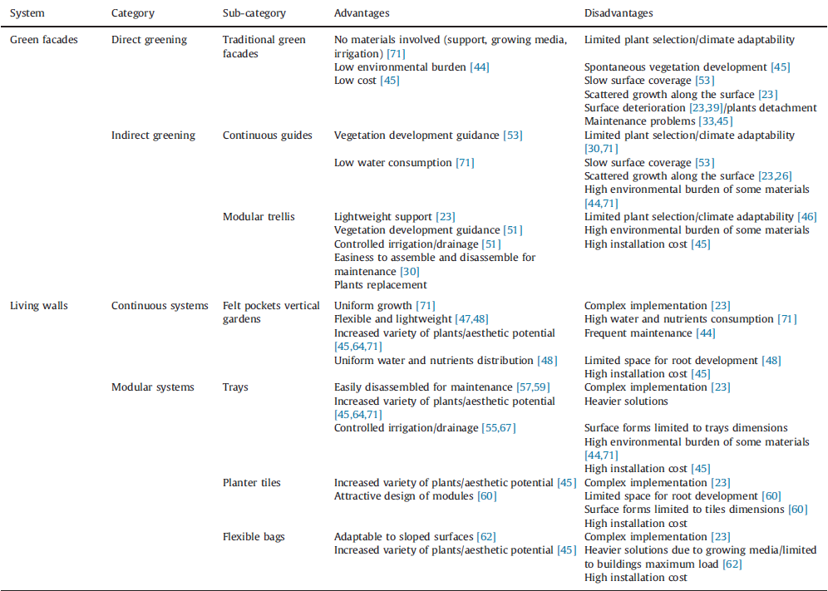
Comparison of green wall systems
advantages and disadvantages

Slide 14
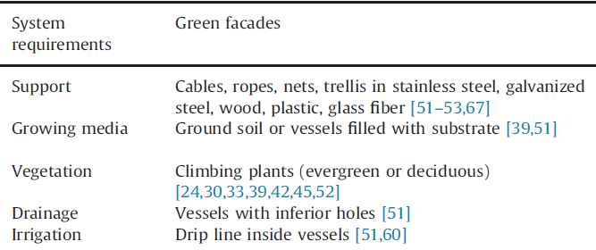
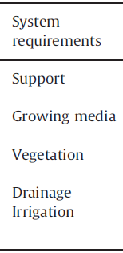
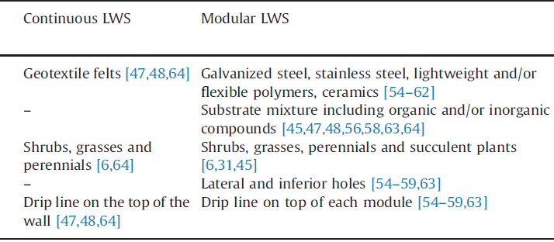
Summary of green wall systems composition

Slide 15
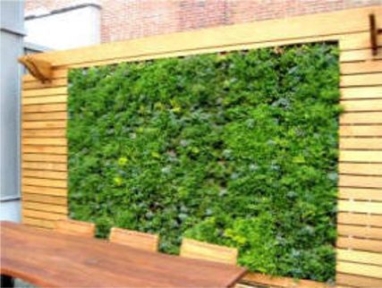
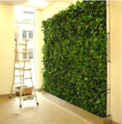
Living Wall
Living Walls can also be migrated into two distinct categories: • Hydroponics wall which uses recirculation water to deliver nutrients directly to the roots of the plant material. • Soil or growing media based walls. These walls are made up of a variety of modules that retain growth media to support plant material.

Slide 16
Living Wall
There are 5 components to a living Wall:
Stainless Steel Frames: Can be mounted on concrete, CMU, metal or wood frame structures.
Stainless Steel Panels: One sq ft standard panels or panels can be custom sized.
Growth Media: Organic coconut coir fibre
Plants: 1” or 2” cells pre-grown into the panels
Remote Monitoring Irrigation/Fertilization System: Computerized vertical drip irrigation system with temperature, moisture and freeze-thaw sensors monitored by GSky® personnel.

Slide 17
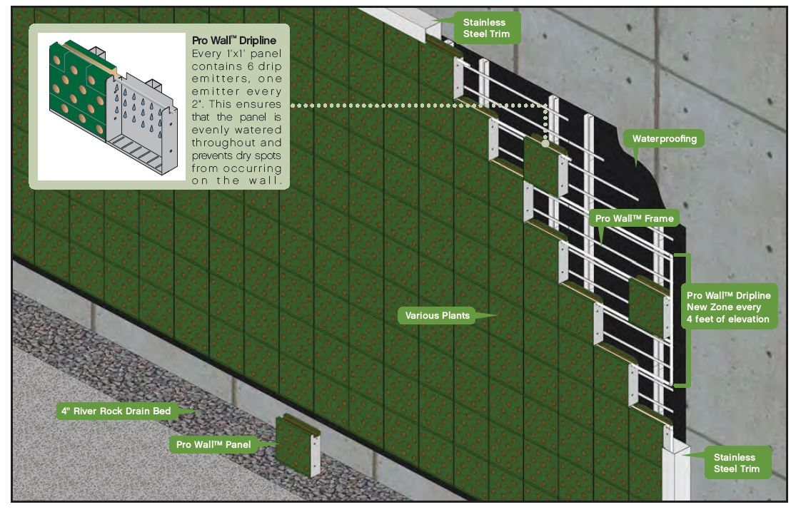
Living Wall

Slide 18
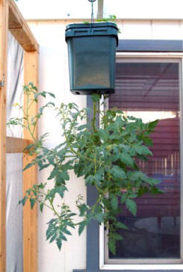
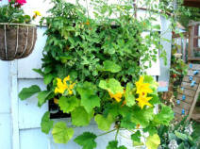
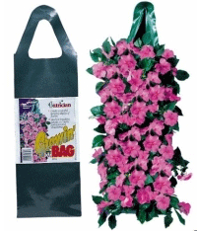
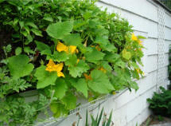
Living Wall Panel
Old options for growing vertical or at least elevated crops can be demonstrated here using an old cat litter container with a hole drilled in the bottom and painted green.

Slide 19
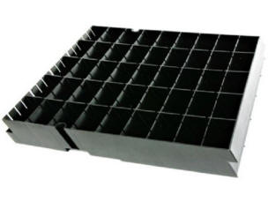
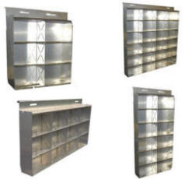
Living Wall Panel
The standard ELT living wall panel has a 2.25” depth and would be best suited for fast growing leafy greens and some shallow rooted herbs that can be harvested during the early season.

Slide 20
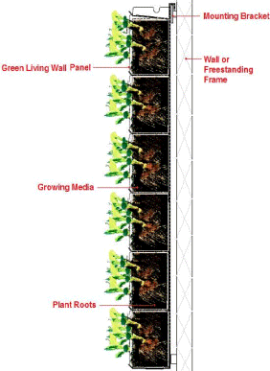
An Intensive Green Wall- Panel System
Notes:
The first layer is the frame that is mounted on to the building with no damage to the original walls. The next layer is a waterproof panel to protect the building when the plants are being watered. If the green wall is larger and has more than an aesthetic purpose, an irrigation system can be installed. This reduces weekly maintenance and makes the wall more self-sustaining. Most intensive living walls have a panel installation system as opposed to one large complete wall. These individual panels contain the medium and soil where the plants root and are attached to the frame. The panels can be removed separately after the green wall is installed for easier maintenance

Slide 21
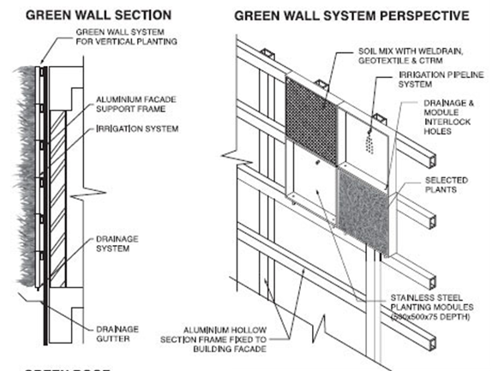
Cross-Sectional View of
an Intensive Green Wall- Panel System
Notes:
The first layer is the frame that is mounted on to the building with no damage to the original walls. The next layer is a waterproof panel to protect the building when the plants are being watered. If the green wall is larger and has more than an aesthetic purpose, an irrigation system can be installed. This reduces weekly maintenance and makes the wall more self-sustaining. Most intensive living walls have a panel installation system as opposed to one large complete wall. These individual panels contain the medium and soil where the plants root and are attached to the frame. The panels can be removed separately after the green wall is installed for easier maintenance

Slide 22
Hydroponic Living Walls
Like green walls in general, hydroponic techniques are not new; the Greek term “Hydro” means water and “Ponos” is labor.
Passive hydroponic systems: it works without a pump and utilizes a wicking fabric or some type of inorganic media that that draws water to the roots.
Active hydroponic systems: “active” means with a mechanical pump (which is the common for hydroponic living walls). In an active system, moving water is infused with chemical nutrients as it passes over the roots.
Need: Medias / root support structures, clean water, temperatures, pH levels, lighting, nutrient solutions, and oxygen exchange (oxygen to nutrient ratios), are part of the synchronization of successful hydroponic walls.
Notes:
http://www.greenroofs.com/content/hydroponic_living_walls_diy_really.htm

Slide 23
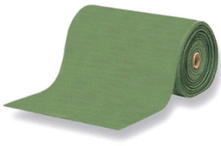
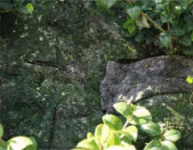
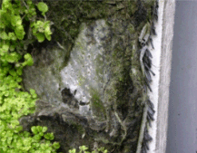
Hydroponic Living Walls
Rooting Media:
Felt fabrics, coco husk and porous sheets of scrub pads (mineral or rock wool) and porous foam are the most popular types of rooting media materials.
Left to Right: hydroponic capillary mat; felt fabric; capillary fabric with plastic lining and geo-textile backing
Notes:
http://www.greenroofs.com/content/hydroponic_living_walls_diy_really.htm

Slide 24
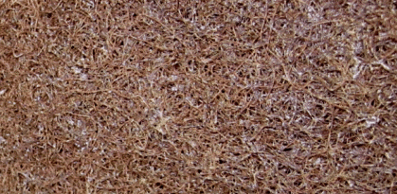
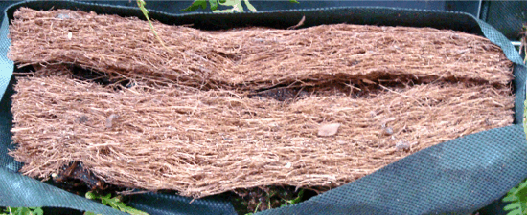
Hydroponic Living Walls
Rooting Media:
Felt fabrics, coco husk and porous sheets of scrub pads (mineral or rock wool) and porous foam are the most popular types of rooting media materials.
Left: 3M Doodlebug Right: Coco husk block inserted into a geo-textile bag by GSky
Notes:
http://www.greenroofs.com/content/hydroponic_living_walls_diy_really.htm

Slide 25
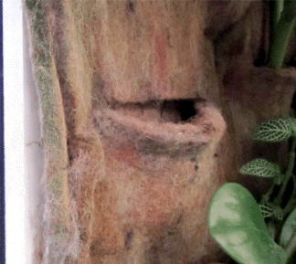
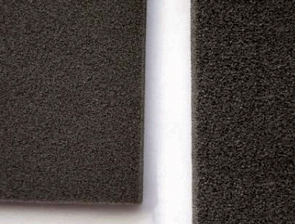
Hydroponic Living Walls
Rooting Media:
Felt fabrics, coco husk and porous sheets of scrub pads (mineral or rock wool) and porous foam are the most popular types of rooting media materials.
Left: Polyester weave (manufacturer unknown); Right: open cell polymer foam blocks similar use by Eco-Walls
Notes:
http://www.greenroofs.com/content/hydroponic_living_walls_diy_really.htm

Slide 26
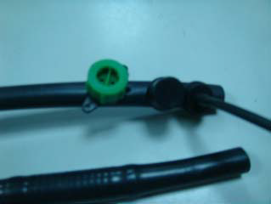
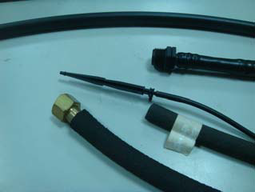
Hydroponic Living Walls
Water Solution: pumped up and allowed to drip through the media back to a reservoir.
Pending the size of your wall, freestanding or wall mounted, you need a reservoir, pump, inorganic media (what will physically hold the plants), test kits and sterile tools. For larger walls and walls exposed to evaporation, a fill float can be retro fitted to the reservoir.
Left: dropping water faucet; Right: soft-type water pipe
Notes:
http://www.greenroofs.com/content/hydroponic_living_walls_diy_really.htm

Slide 27
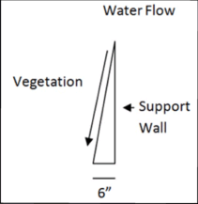
Hydroponic Living Walls
Construction:
In most cases the walls are flat at
a true 90 degrees. This tapered angle,
however, will prevent the irrigation
water from dripping off the leaves
allowing it to follow the angle of
the rooting media.
Notes:
http://www.greenroofs.com/content/hydroponic_living_walls_diy_really.htm

Slide 28
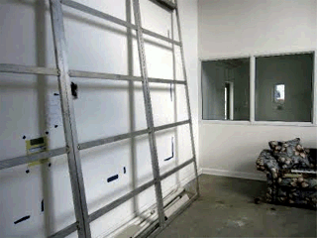
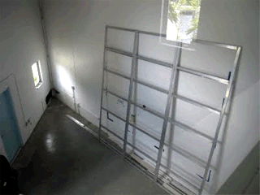
Hydroponic Living Walls
Construction:
Step 1: Armature and Mounting Framework
Notes:
http://www.greenroofs.com/content/hydroponic_living_walls_diy_really.htm

Slide 29
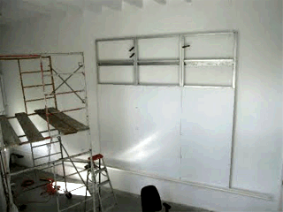
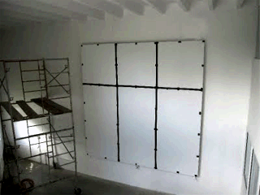
Hydroponic Living Walls
Construction:
Step 2: Mounting the PVC Sheets
Notes:
http://www.greenroofs.com/content/hydroponic_living_walls_diy_really.htm

Slide 30
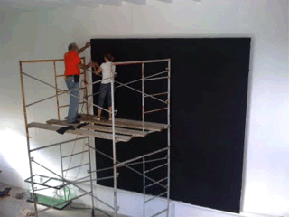
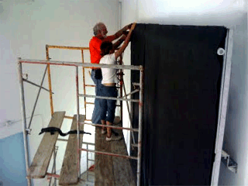
Hydroponic Living Walls
Construction:
Step 3: Mounting the Rooting Media
Notes:
http://www.greenroofs.com/content/hydroponic_living_walls_diy_really.htm

Slide 31
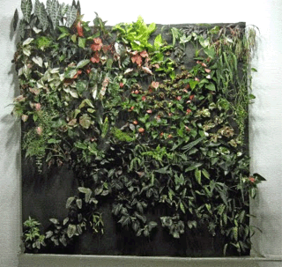
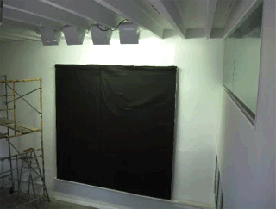
Hydroponic Living Walls
Construction:
Rooting Media Complete, with Partial Plant Installation:
Notes:
http://www.greenroofs.com/content/hydroponic_living_walls_diy_really.htm

Slide 32
Irrigation System for Hydroponic Living Walls
There are two options that the irrigation systems start with the water source or supply also known as the point of connection.
An ebb and flow system will contain a water reservoir with fertilizer already premixed.
Connect directly to potable water. The water moves through a supply line from the the point of connection into a fertilizer source through a valve and filters and then to the specified watering “zone” controlled by the “zone valves.” The zone is a defined area of the wall in which water is applied. The number of zones is dependent on the size of the wall.
Notes:
http://www.greenroofs.com/content/hydroponic_living_walls_diy_really.htm

Slide 33
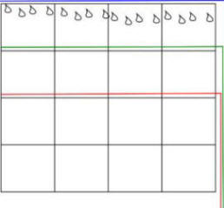
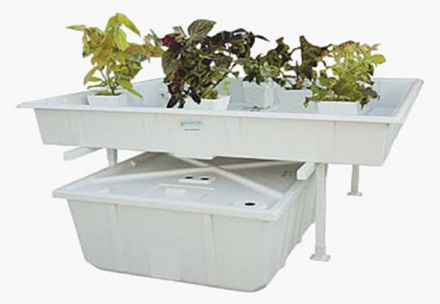
Hydroponic Living Walls
Typical Ebb and Flow Cycle for Horizontal Hydroponic Applications
Ebb and Flow Kit - Left: Tray with grow blocks or pots Right: Reservoir, Fertilizer and Pump
Notes:
http://www.greenroofs.com/content/hydroponic_living_walls_diy_really.htm

Slide 34
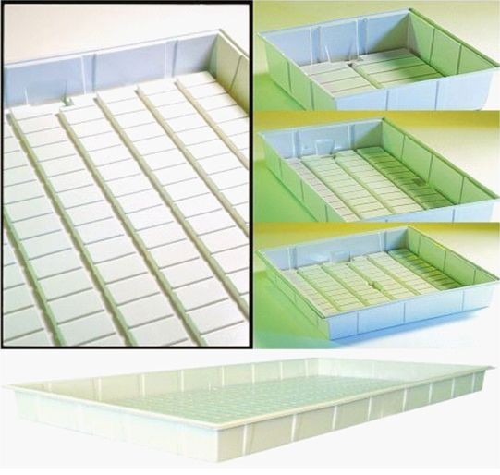
Typical Ebb and Flow Cycle for Horizontal Hydroponic Applications
Typical horizontal hydroponics are designed as an ebb and flow system and require a tray.
The tray is segmented and elevates the grow blocks or containers so they are not sitting in water, and utilize a reservoir and a pump.
Hydroponic tray shown with channels that allows water and nutrients to flood the tray and recede back to the reservoir. The plant roots literally sit up and out of the water that is left in the tray preventing root rot due to anaerobic activity.
Notes:
http://www.greenroofs.com/content/hydroponic_living_walls_diy_really.htm

Slide 35
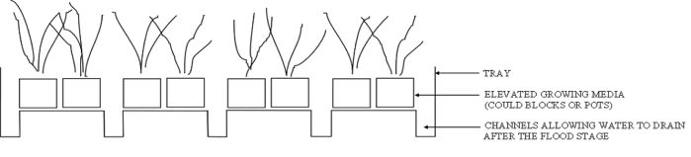


Typical Ebb and Flow Cycle for Horizontal Hydroponic Applications
These three diagrams
show the water flow
cycle flooding the root
area with nutrients and
then receding back to
the reservoir.
Notes:
http://www.greenroofs.com/content/hydroponic_living_walls_diy_really.htm

Slide 36

Irrigation System for Hydroponic Living Walls
1. Point of Connection (POC) 2. Zone Valve with Filter 3. Fertilizer Injection 4. Automated Timer
Notes:
http://www.greenroofs.com/content/hydroponic_living_walls_diy_really.htm

Slide 37

Irrigation System for Hydroponic Living Walls
Notes:
http://www.greenroofs.com/content/hydroponic_living_walls_diy_really.htm

Slide 38

Irrigation System for Hydroponic Living Walls
This photo depicts the reservoir used to irrigate this living wall. This is the “Source” for this irrigation system.
Notes:
http://www.greenroofs.com/content/hydroponic_living_walls_diy_really.htm

